Slide 1


Slide 2
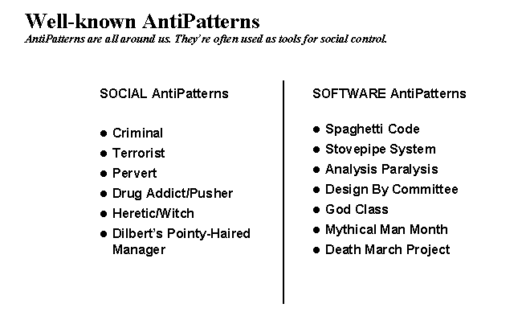
Notes:
Analysis paralysis: Devoting disproportionate effort to the analysis phase of a project
Cash cow: A profitable legacy product that often leads to complacency about new products
Design by committee: The result of having many contributors to a design, but no unifying vision
Escalation of commitment: Failing to revoke a decision when it proves wrong
Management by perkele: Authoritarian style of management with no tolerance for dissent
Moral hazard: Insulating a decision-maker from the consequences of his or her decision.
Mushroom management: Keeping employees uninformed and misinformed (kept in the dark and fed manure)
Stovepipe: A structure that supports mostly up-down flow of data but inhibits cross organizational communication
Vendor lock-in: Making a system excessively dependent on an externally supplied component^{[4]}
A "God Class" is an object that controls way too many other objects in the system and has grown beyond all logic to become The Class That Does Everything.
e Mythical Man-Month: Essays on Software Engineering is a book on software engineering and project management by Fred Brooks, whose central theme is that "adding manpower to a late software project makes it later".
death march is a dysphemism for a project that is destined to fail. Usually it is a result of unrealistic or overly optimistic expectations in scheduling, feature scope, or both, and often includes lack of appropriate documentation, or any sort of relevant training.

Slide 3
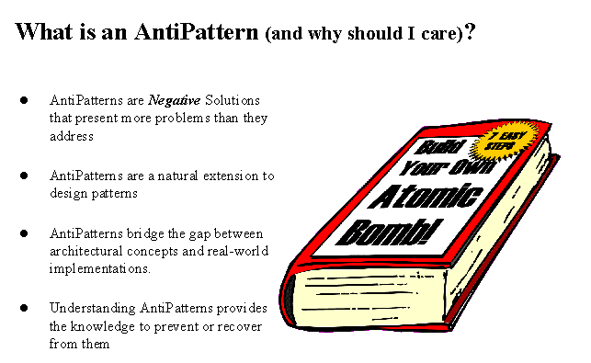

Slide 4
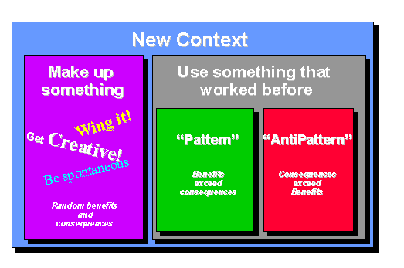

Slide 5
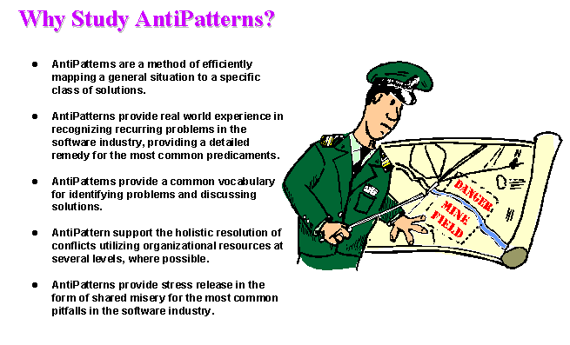

Slide 6
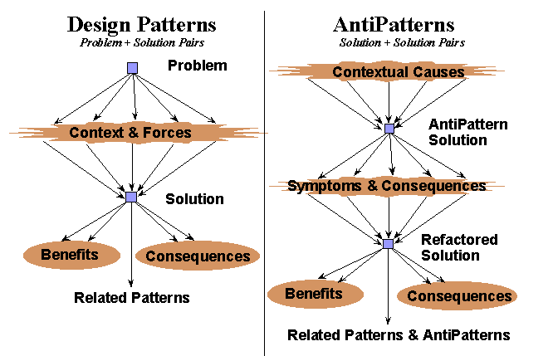

Slide 7
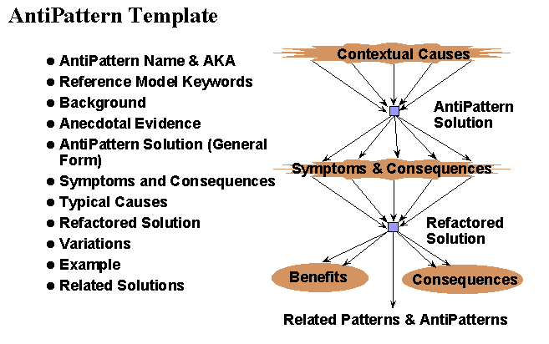

Slide 8
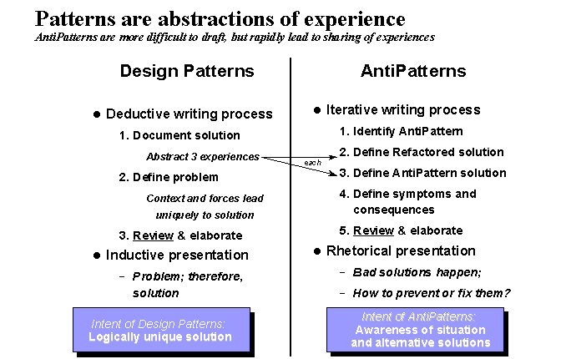

Slide 9
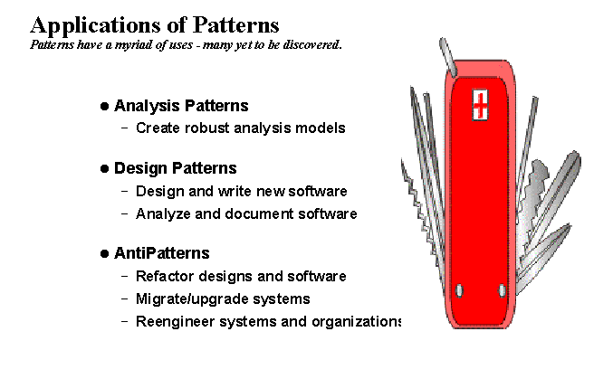

Slide 10
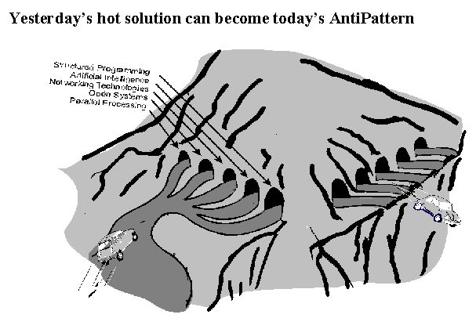

Slide 11
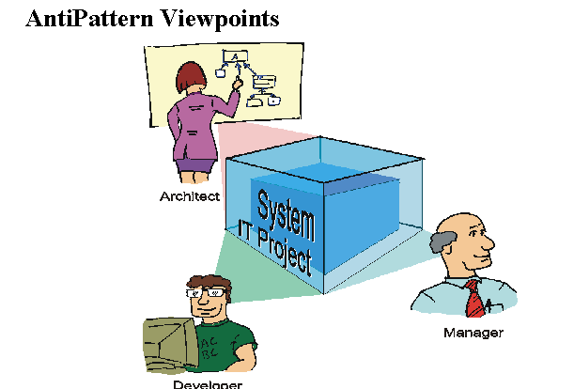

Slide 12
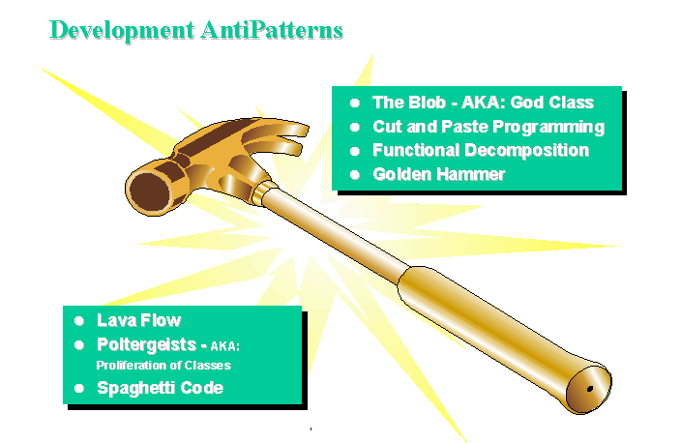

Slide 13
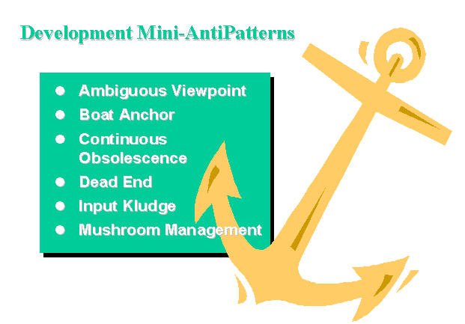

Slide 14
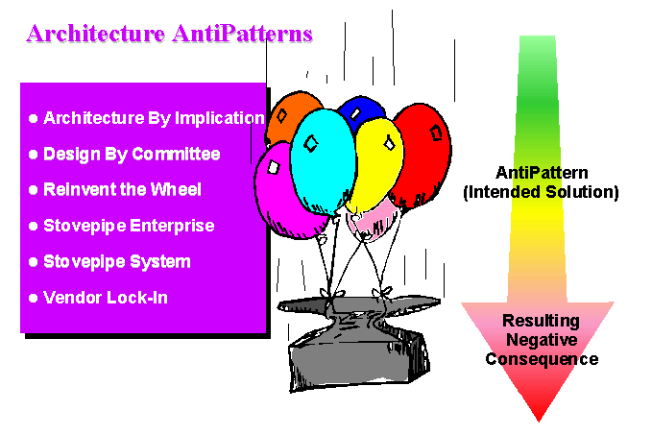

Slide 15
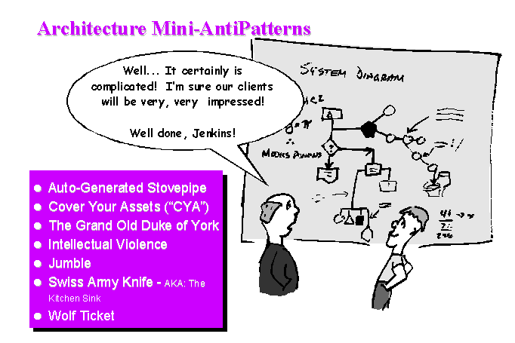

Slide 16
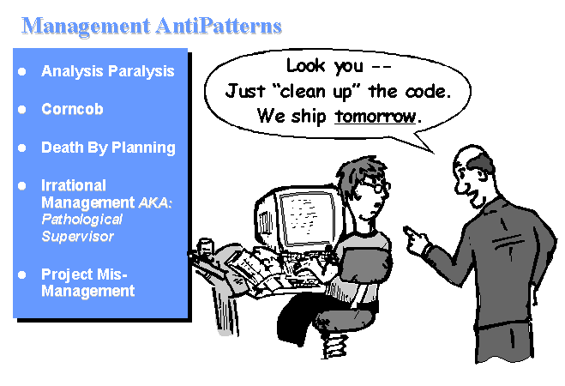

Slide 17
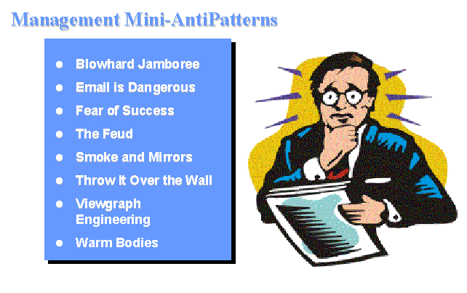

Slide 18


Slide 19
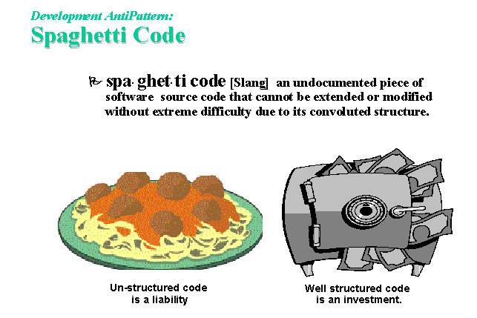

Slide 20
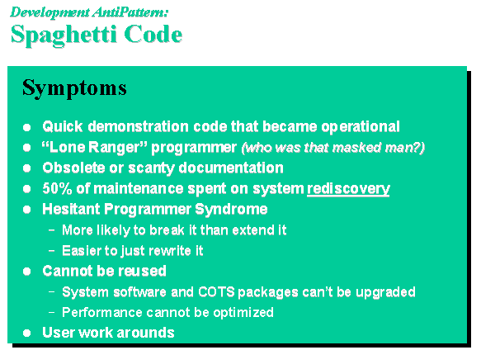

Slide 21
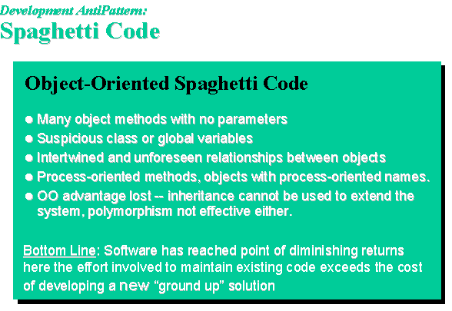

Slide 22
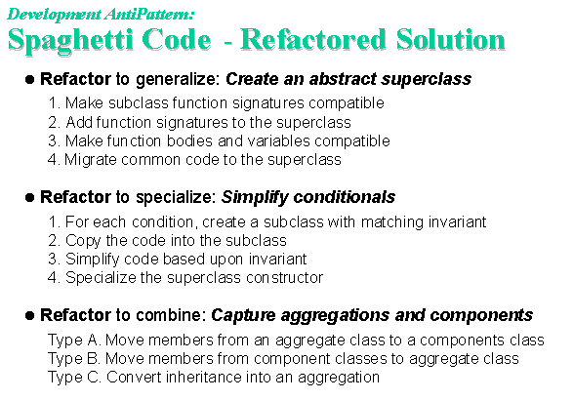

Slide 23
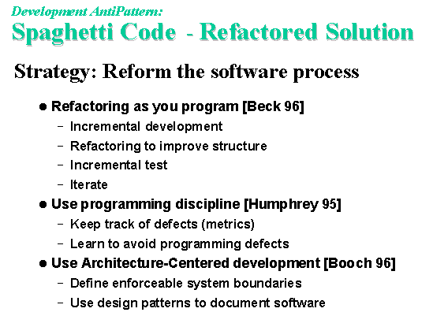

Slide 24
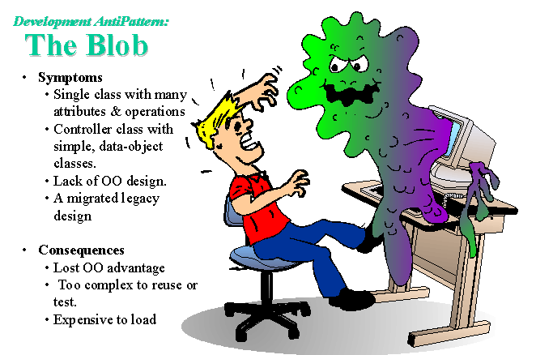

Slide 25
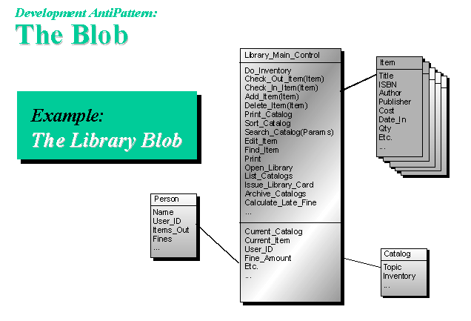

Slide 26
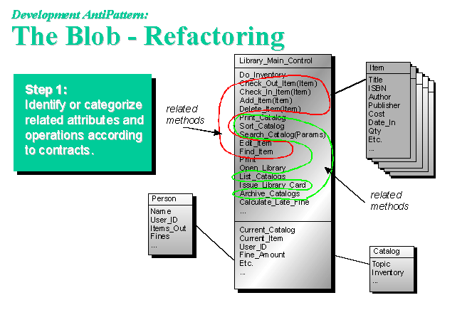

Slide 27
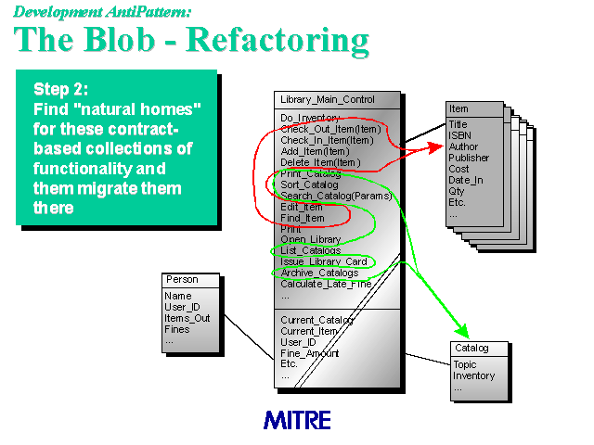

Slide 28
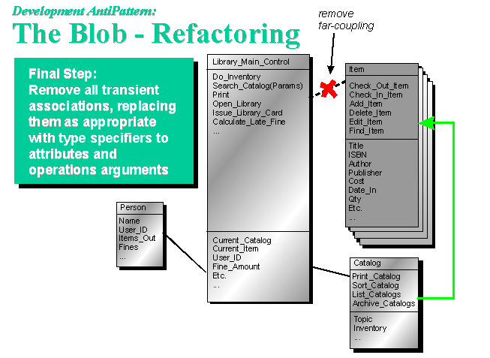

Slide 29
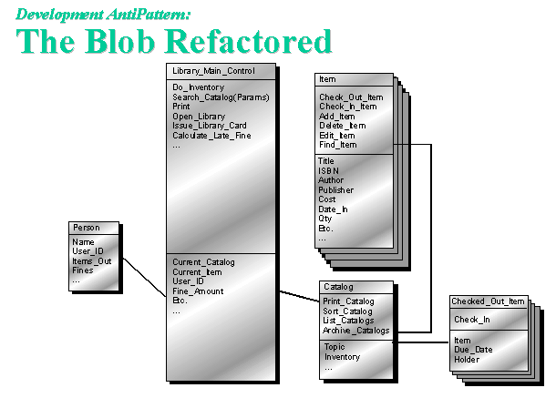

Slide 30
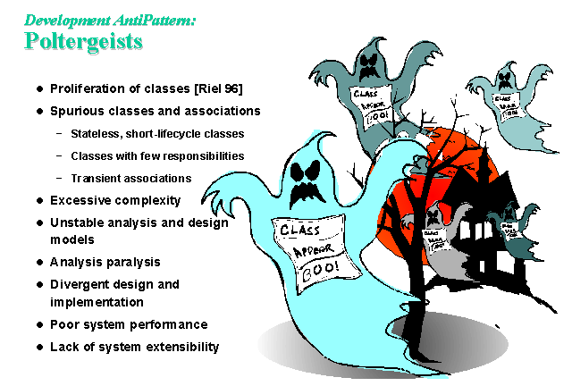

Slide 31
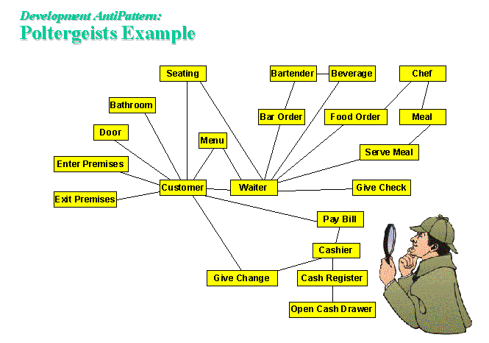

Slide 32
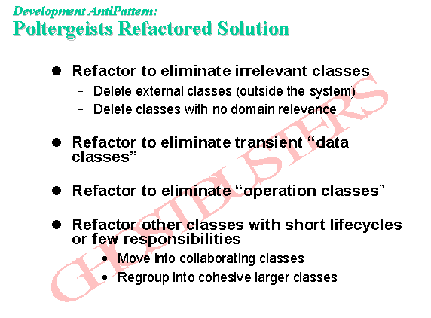

Slide 33
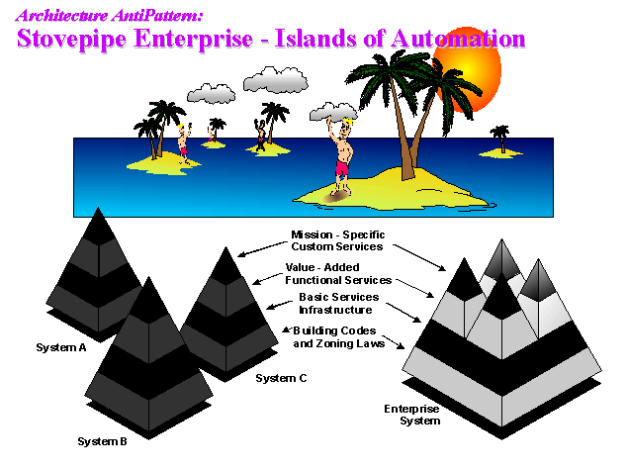

Slide 34
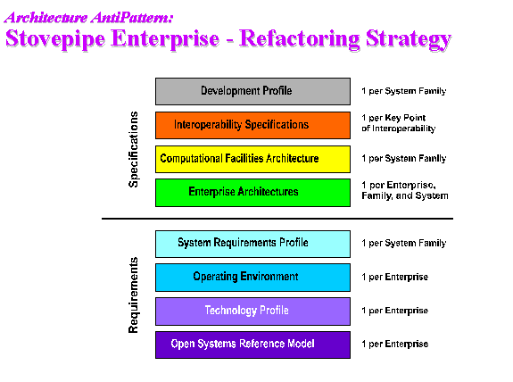

Slide 35
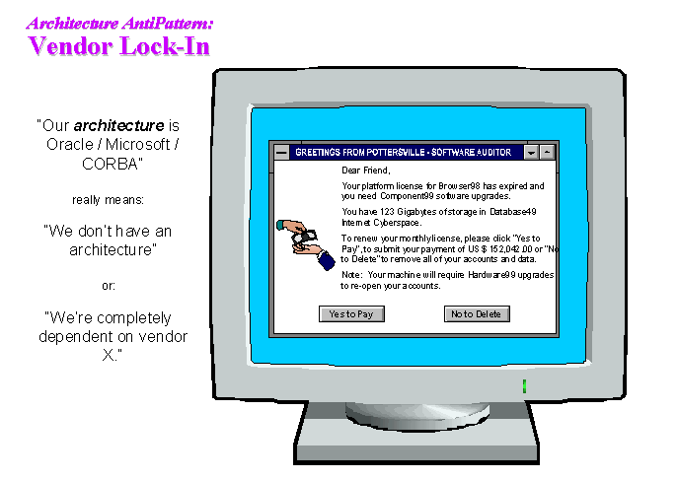

Slide 36
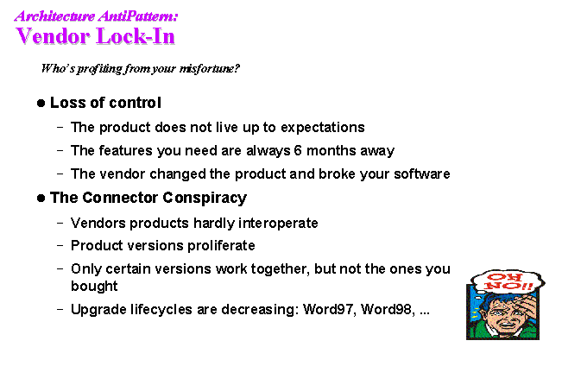

Slide 37
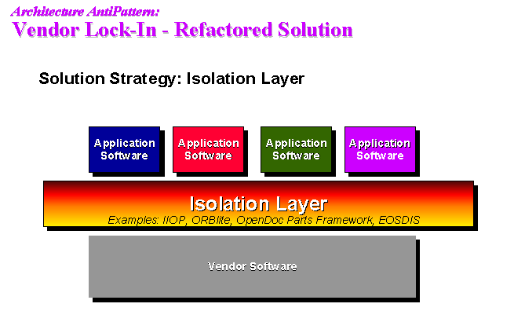

Slide 38
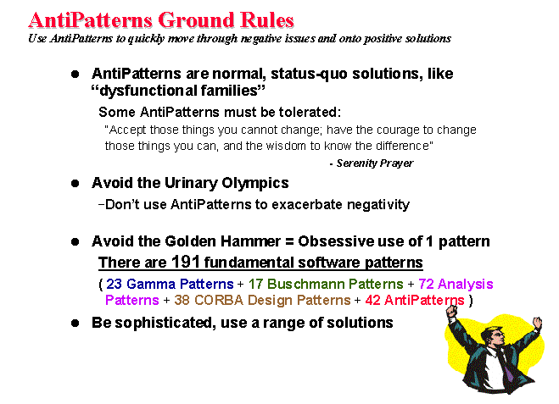

Slide 39
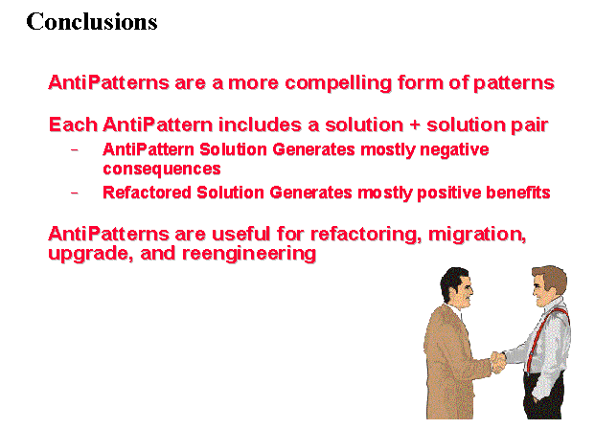

Slide 40
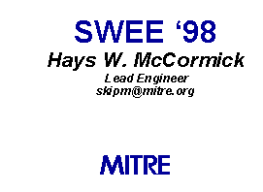
Any Questions?

